Slide 1
Discretization
Discretization:
  divide the range of a continuous attribute into intervals
  Some classification algorithms only accept categorical attributes.
Experimental results indicate that with discretization
  data size can be reduced
  classification accuracy can be improved

Slide 2
Discretization
Store only the interval labels
Important for association rules and classification
age | 5 | 6 | 6 | 9 | … | 15 | 16 | 16 | 17 | 20 | … | 24 | 25 | 41 | 50 | 65 | … | 67
own a car | 0 | 0 | 0 | 0 | … | 0 | 1 | 0 | 1 | 1 | … | 0 | 1 | 1 | 1 | 1 | … | 1
Age [5,15]
Age [16,24]
Age [25,67]

Slide 3
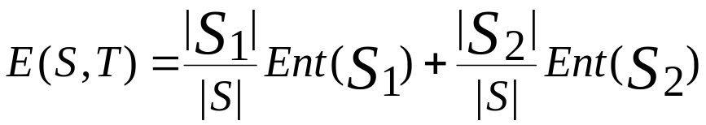

Entropy-Based Discretization
Given a set of samples S, if S is partitioned into two intervals S1 and S2 using boundary T, the entropy after partitioning is
The boundary that minimizes the entropy function over all possible boundaries is selected as a binary discretization.
The process is recursively applied to partitions obtained until some stopping criterion is met, e.g.,

Slide 4

Example 1
ID | 1 | 2 | 3 | 4 | 5 | 6 | 7 | 8 | 9
Age | 21 | 22 | 24 | 25 | 27 | 27 | 27 | 35 | 41
Grade | F | F | P | F | P | P | P | P | P
Let Grade be the class attribute. Use entropy-based discretization to divide the range of ages into different discrete intervals.
There are 6 possible boundaries. They are 21.5, 23, 24.5, 26, 31, and 38.
Let us consider the boundary at T = 21.5.
  Let S1 = {21}
  S2 = {22, 24, 25, 27, 27, 27, 35, 41}
(22+24) / 2 = 23
(21+22) / 2 = 21.5

Slide 5
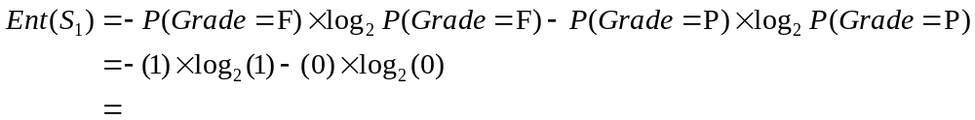

Example 1 (cont’)
ID | 1 | 2 | 3 | 4 | 5 | 6 | 7 | 8 | 9
Age | 21 | 22 | 24 | 25 | 27 | 27 | 27 | 35 | 41
Grade | F | F | P | F | P | P | P | P | P
The number of elements in S1 and S2 are:
    |S1| = 1
    |S2| = 8
The entropy of S1 is
The entropy of S2 is

Slide 6
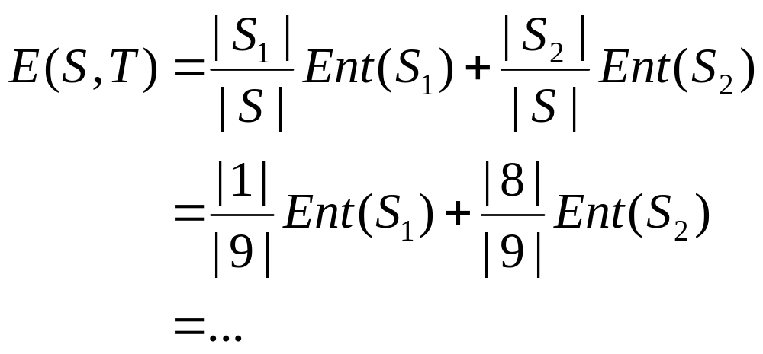
Example 1 (cont’)
Hence, the entropy after partitioning at T = 21.5 is

Slide 7
Example 1 (cont’)
The entropies after partitioning for all the boundaries are:
T = 21.5 = E(S,21.5)
T = 23 = E(S,23)
.
.
T = 38 = E(S,38)
Select the boundary with the smallest entropy
Suppose best is T = 23
Now recursively apply entropy discretization onto both partitions
ID | 1 | 2 | 3 | 4 | 5 | 6 | 7 | 8 | 9
Age | 21 | 22 | 24 | 25 | 27 | 27 | 27 | 35 | 41
Grade | F | F | P | F | P | P | P | P | P

Slide 8
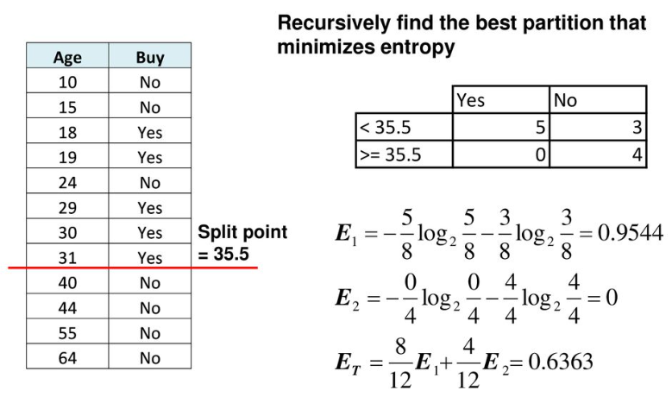
Example 2

Slide 9
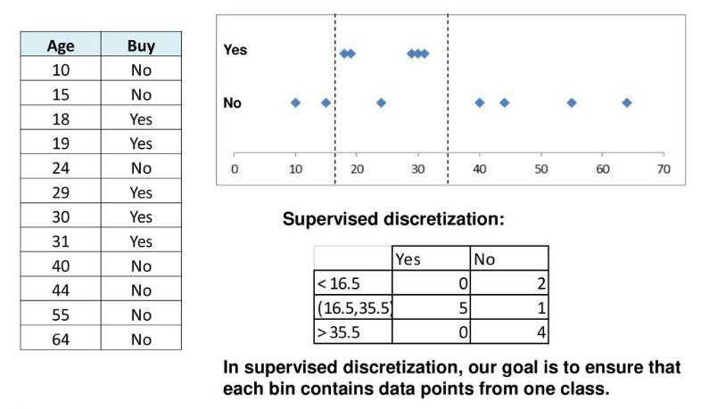
Supervised Discretization

Slide 10
Unsupervised Binning Method
Attribute values (for one attribute e.g., age):
  0, 4, 12, 16, 16, 18, 24, 26, 28
Equi-width binning – for bin width of e.g.,: 3
  Bin 1: 0, 4 [-,10) bin
  Bin 2: 12, 16, 16, 18 [10,20) bin
  Bin 3: 24, 26, 28 [20,+) bin
  – denote negative infinity, + positive infinity
Equi-frequency binning – for bin density of e.g., 3:
  Bin 1: 0, 4, 12 [-, 14) bin
  Bin 2: 16, 16, 18 [14, 21) bin
  Bin 3: 24, 26, 28 [21,+] bin

Slide 11
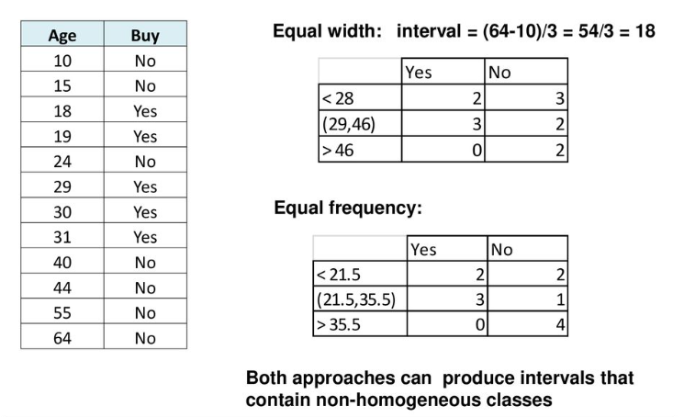
Unsupervised Binning Method

